Slide 1

03
Model Performance Evaluation

Slide 2
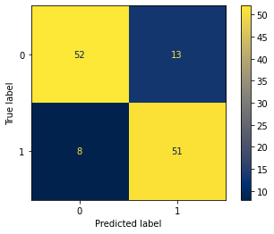
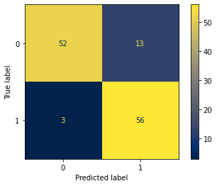

Confusion matrix plots
Used statistics:
Accuracy: The ratio of correctly classified observations to all observations.
Precision: The ratio of correctly classified observations to the positive class to all observations classified as the positive class.
Match Error Rate (MER): The ratio of incorrectly classified observations to all observations.
Sensitivity: The ratio of correctly classified observations to the positive class to the sum of observations correctly classified to the positive class and observations incorrectly classified to the negative class.
F1 Score: The harmonic mean between precision and sensitivity.
Specificity: The ratio of correctly classified observations to the negative class to all observations classified as the negative class.
Gradient Boosting
AdaBoost
SVM

Slide 3
Performance metrics for each model
 | AdaBoost | Gradient Boosting | SVM
Accuracy | 0.871 | 0.831 | 0.855
Precision | 0.812 | 0.797 | 0.8
MER | 0.129 | 0.169 | 0.145
Sensitivity | 0.949 | 0.864 | 0.91
F1 Score | 0.875 | 0.829 | 0.85
Specificity | 0.8 | 0.8 | 0.8
From the above table, it can be inferred that the AdaBoost model achieved the highest levels of accuracy, precision, MER, sensitivity, and F1 score. Specificity has the lowest value for the AdaBoost, Gradient Boosting, and SVM models (0.8). In summary, based on the performance metrics, the AdaBoost model emerges as the best-performing model.

Slide 4
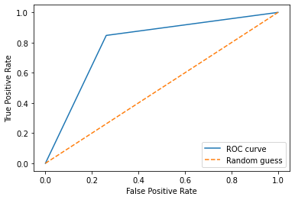
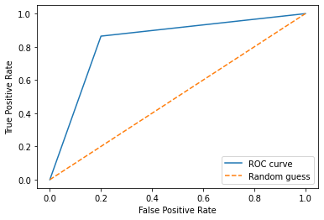
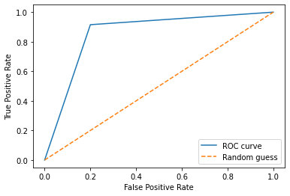
ROC curves and AUC for each models
Another tool for evaluating classifier performance is the ROC curve, which illustrates how True Positive Rate changes with False Positive Rate. Below are the ROC curves presented for each model.
Gradient Boosting
AdaBoost
SVM
 | AdaBoost | Gradient Boosting | SVM
AUC | 0.875 | 0.731 | 0.858

Slide 5

SUMMARY
The report compared three machine learning models - AdaBoost, Gradient Boosting, and Support Vector Machine - in predicting stroke occurrence using a modified dataset with under sampling (496 observations). AdaBoost consistently outperformed, displaying the highest metrics and the largest area under the ROC curve. Support Vector Machine also proved effective, while Gradient Boosting showed weaker predictive power. It's important to note that under sampling might impact real-world predictive performance due to data imbalance adjustments.

Slide 6
THANK YOU FOR ATTENTION!
Authors:
Bogdan Yanovich
Aliaksandr Mazur
Aliaksandr Zaman

